Slide 1

Detecting infected
forests
Nikola Tomažin
Tin Komerički
Marko Vuković
02.10.2019.

Slide 2

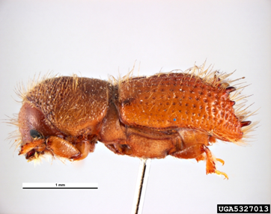
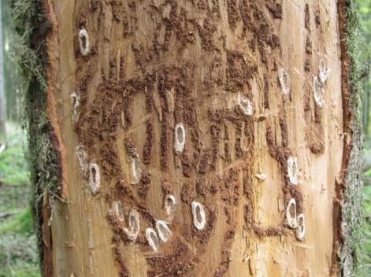
Problem
Forests being infected by various insects and diseases
One of the main forest pests in Croatia is bark beetle (Scolytinae)
Timely detection is the key in its prevention of spread throught removal of infected trees

Slide 3
Solution
In person measuring forest health
Takes a lot of time and resources
Drone usage
Expensive
Using a satellite
The most expensive method, but the satellites are already in the orbit and it’s free to use their data

Slide 4
Hypothesis
According to the Wset et al. (2003) plant infection based on spectral information relies on the properties of the light emerging from the canopy after multiple interactions i.e. reflections, transmissions and absorptions
Measuring the visible (400-700 nm), near infrared (700-1200 nm) and shortwave infrared (1200-2400 nm) spectrum infected parts of the forest can be detected

Slide 5
How
Using Copernicus Sentinel 2 data and extracting radiation measurements
Continuously analysing data from the satellites will allow us finding forests in the early stages of infection
Comparing them to:
Radiation levels of healthy plants
Measurements taken some time ago

Slide 6
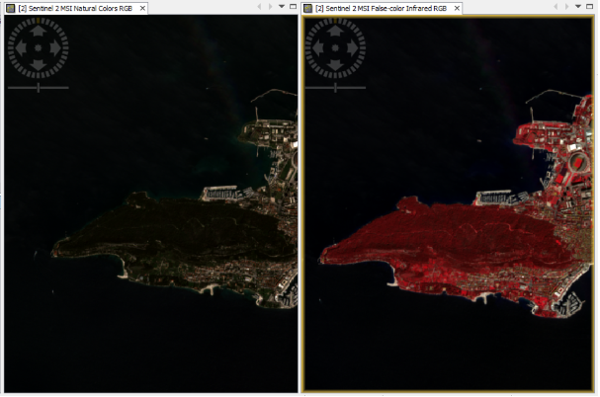
Region without and with infrared filter
With infrared filter
Without filter
Marjan park in Split

Slide 7
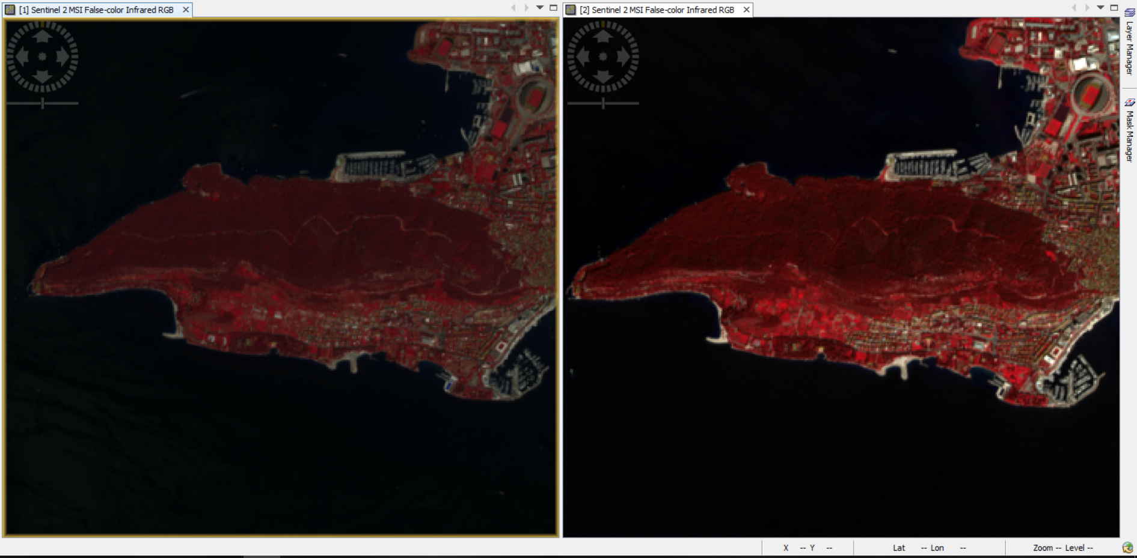
Not infected vs infected forest
Not infected
Infected
3.2015.
4.2018.

Slide 8

FER STUDENT
SATELLITE PROJECT
Questions?

